Slide 1
Discovering and Investigating Propagated Vulnerabilities from Ethereum to Its Layer-2 Blockchains
Dr. Daoyuan Wu
Research Assistant Professor, HKUST
TRACK 1
30 AUG

Slide 2
Ethereum is the most popular blockchain for hosting smart contracts
Crowdfunded and Development begun in 2014.
The PoW (Proof-of-Work) network went live on 30 July 2015.
Switched to PoS (Proof-of-Stake) on 26 Feb 2023.
More than 2B (2,487,725,064 as of Aug 26) transactions sent.
More than 1M (1,344,143 as of Aug 26) token contracts created.
Ethereum’s smart contract language, Solidity, appears in Top Programming Languages 2024.
Notes:
https://spectrum.ieee.org/top-programming-languages-2024

Slide 3
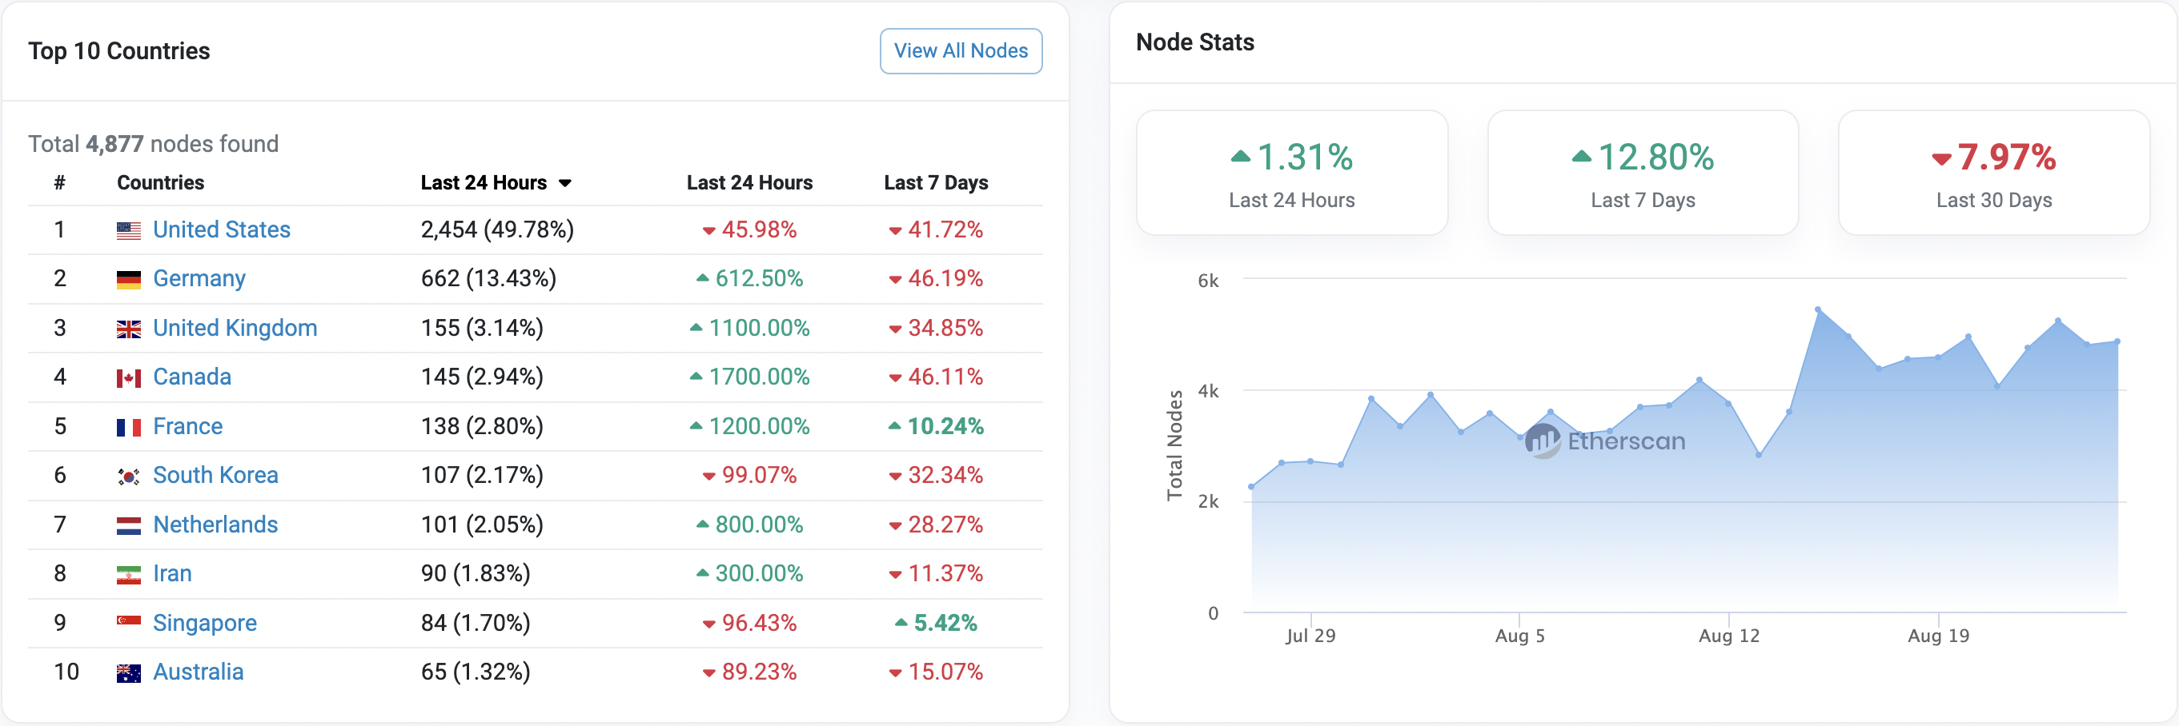
Ethereum is also quite decentralized

Slide 4
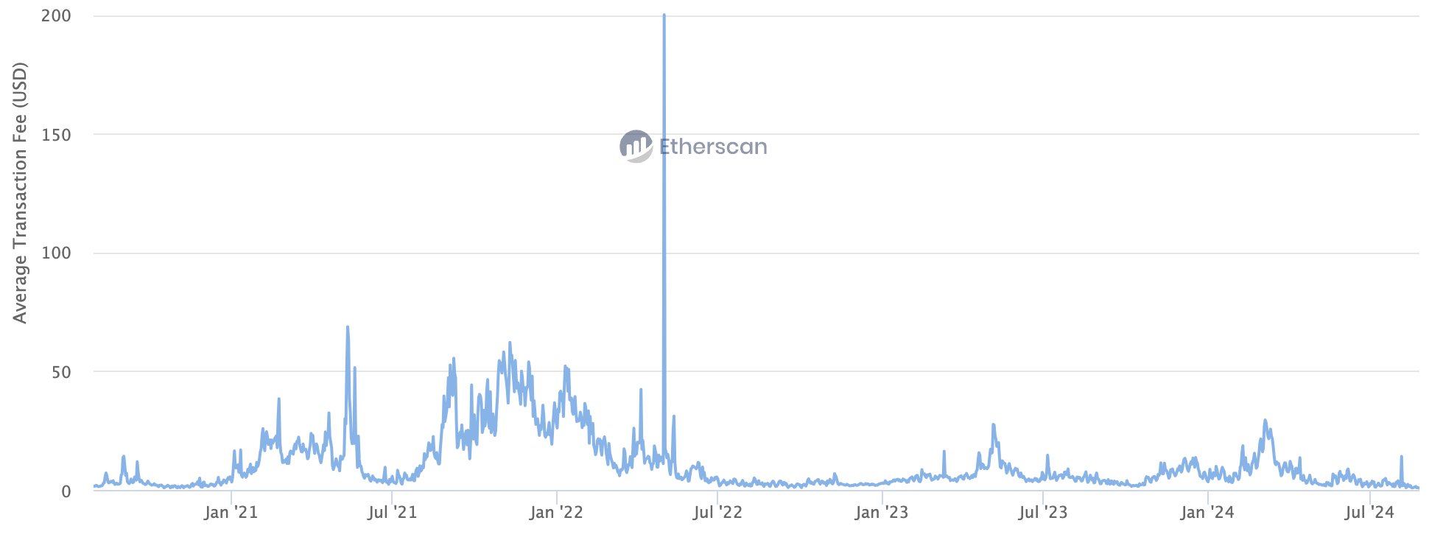
Ethereum suffers from low throughput and expensive transaction fees
Ethereum currently has only 14.3 TPS (transactions per second).
The transaction fee is now around 1USD in the bear market but was high in the past.

Slide 5
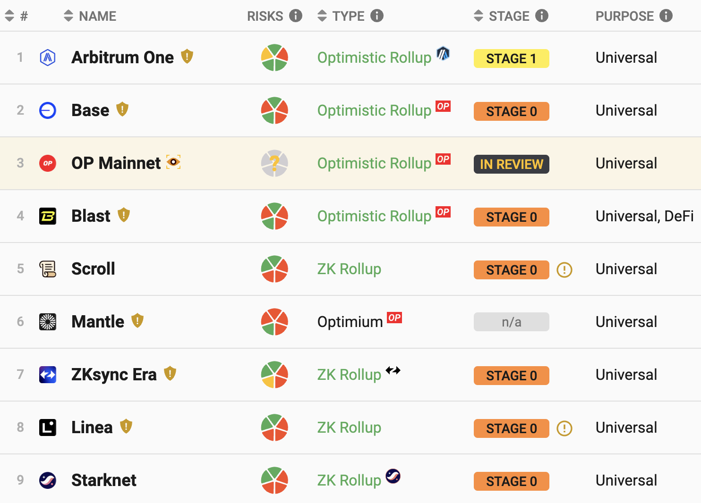
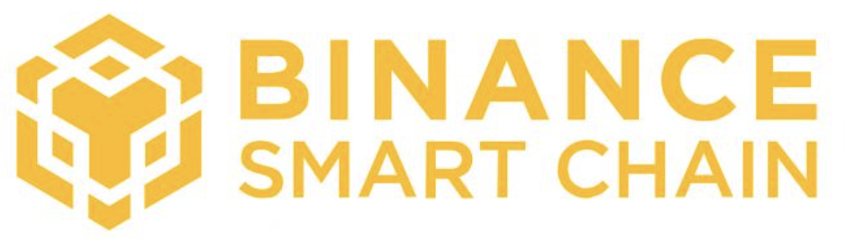



Third-party layer-2 blockchain networks have emerged in recent years
Notes:
https://l2beat.com/scaling/summary

Slide 6
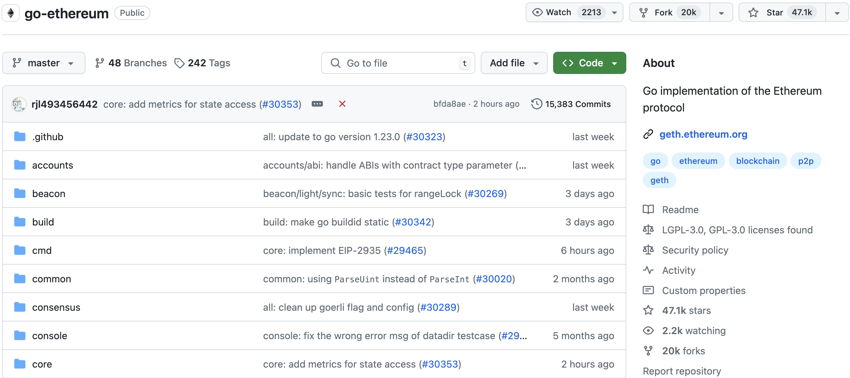
They copy & customize Ethereum

Slide 7
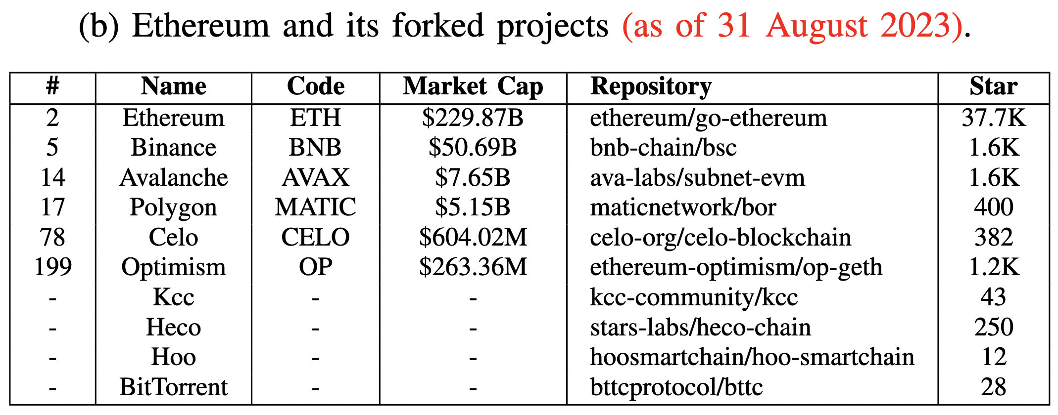
They copy & customize Ethereum

Slide 8
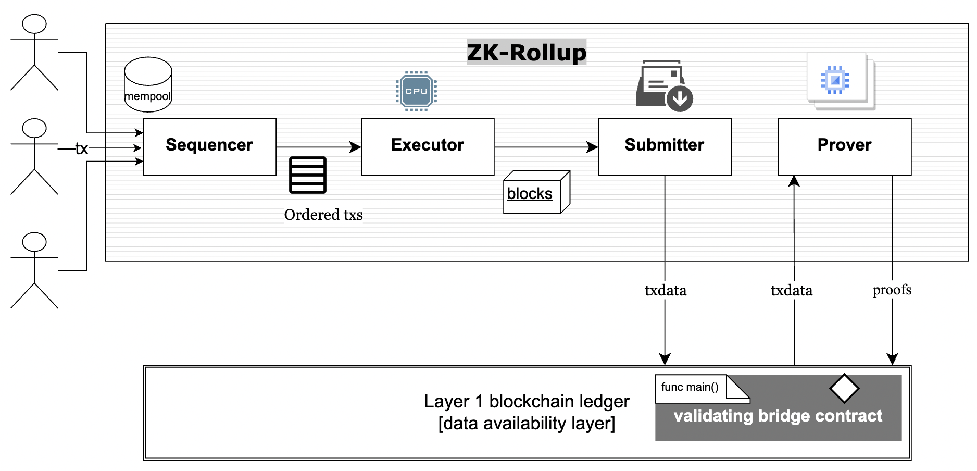
The architecture between Ethereum and its layer-2 blockchain networks
EVM
Ethereum
Source: arXiv:2310.03616

Slide 9
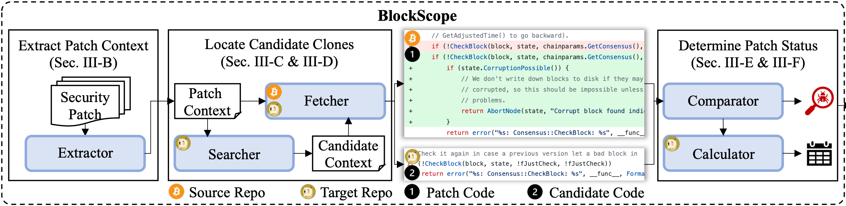
Our Tool: BlockScope
A novel patch-based clone detection tool for propagated vulnerabilities in forked blockchain projects.
1. Leverage patch code contexts to locate only potentially relevant code
2. Adopt similarity-based code match for being immune to clone variants

Slide 10



Context-based Candidate Clone Search
UP context
Source patch code hunk from Bitcoin
Target candidate code hunk from Dogecoin
start statement (ss)
1 |  | AssertLockHeld(cs_main);
2 |  | assert(pindex);
3 |  | assert((pindex->phashBlock == nullptr) ||
4 |  | (*pindex->phashBlock == block.GetHash()));
5 |  | int64_t nTimeStart = GetTimeMicros();
6 | - | if (!CheckBlock(block, state, chainparams.GetConsensus(), !fJustCheck, !fJustCheck))
7 | + | if (!CheckBlock(block, state, chainparams.GetConsensus(), !fJustCheck, !fJustCheck)) {
8 | + | if (state.CorruptionPossible()) {
9 | + | return AbortNode(state, “Corrupt block found ...");
10 |  | return error("%s: Consensus::CheckBlock: %s", __func__, ...);
11 |  | uint256 hashPrevBlock = pindex->pprev == nullptr ? uint256() : ...;
12 |  | assert(hashPrevBlock == view.GetBestBlock());
13 |  | if (block.GetHash() == chainparams.GetConsensus().hashGenesisBlock) {
14 |  | if (!fJustCheck)
1 | bool ConnectBlock(const CBlock& block, CValidationState& state, ...,
2 | CCoinsViewCache& view, const CChainParams& chainparams, bool fJustCheck)
3 | AssertLockHeld(cs_main);
4 | const Consensus::Params& consensus = Params().GetConsensus(pindex->nHeight);
5 | int64_t nTimeStart = GetTimeMicros();
6 | if (!CheckBlock(block, state, !fJustCheck, !fJustCheck))
7 | return error("%s: Consensus::CheckBlock: %s", __func__, ...);
8 | uint256 hashPrevBlock = pindex->pprev == NULL ? uint256() : ...;
9 | assert(hashPrevBlock == view.GetBestBlock());
10 | if (block.GetHash() == Params().GetConsensus(0).hashGenesisBlock) {
11 | if (!fJustCheck)
AssertLockHeld(cs_main);
assert((pindex->phashBlock == nullptr) ||
AssertLockHeld(cs_main);
(*pindex->phashBlock == block.GetHash()));
const Consensus::Params& consensus = Params().GetConsensus(pindex->nHeight);
end statement (es) & key statement (ks)
int64_t nTimeStart = GetTimeMicros();
int64_t nTimeStart = GetTimeMicros();
int64_t nTimeStart = GetTimeMicros();
Determine the boundary ss and es by similarity
if (!CheckBlock(block, state, !fJustCheck, !fJustCheck))
Leverage git grep to find ks in target repo
start statement (ss)
return error("%s: Consensus::CheckBlock: %s", __func__, ...);
return error("%s: Consensus::CheckBlock: %s", __func__, ...);
uint256 hashPrevBlock = pindex->pprev == nullptr ? uint256() : ...;
uint256 hashPrevBlock = pindex->pprev == NULL ? uint256() : ...;
assert(hashPrevBlock == view.GetBestBlock());
key statement (ks)
assert(hashPrevBlock == view.GetBestBlock());
assert(hashPrevBlock == view.GetBestBlock());
if (block.GetHash() == chainparams.GetConsensus().hashGenesisBlock) {
if (block.GetHash() == Params().GetConsensus(0).hashGenesisBlock) {
end statement (es)
if (!fJustCheck)
if (!fJustCheck)
DOWN context

Slide 11


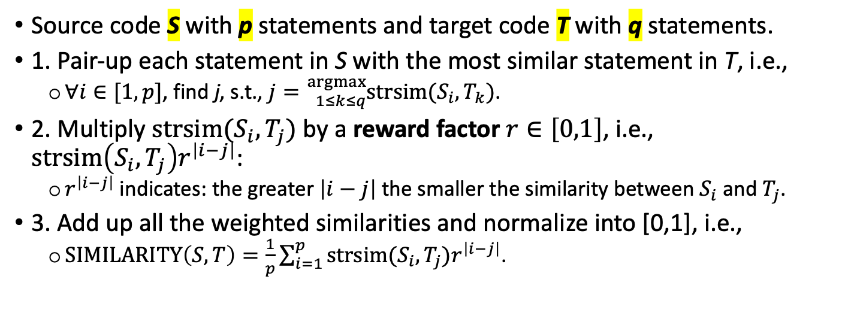
A New Way of Calculating Code Similarity
S p=5
T q=3
Source code S with p statements and target code T with q statements.
1. Pair-up each statement in S with the most similar statement in T, i.e.,
$∀i∈[1,p]$, find j, s.t., $j={}_{1≤k≤q}^{argmax}{strsim(S_{i},T_{k})}$.
2. Multiply $strsim(S_{i},T_{j})$ by a reward factor $r∈\left[0,1\right]$, i.e., $strsim\left(S_{i},T_{j}\right)r^{\left|i−j\right|}$:
$r^{\left|i−j\right|}$ indicates: the greater $\left|i−j\right|$ the smaller the similarity between $S_{i}$ and $T_{j}$.
3. Add up all the weighted similarities and normalize into [0,1], i.e.,
$SIMILARITY\left(S,T\right)=\frac{1}{p}\sum_{i=1}^{p}{strsim(S_{i},T_{j})r^{\left|i−j\right|}}$.
$p≠q$ $\text{issue}$
$$\text{code} \text{ordering} \text{issue}$$

Slide 12
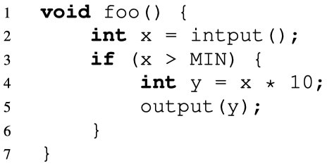
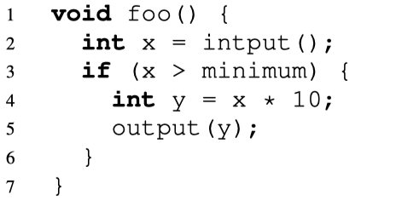
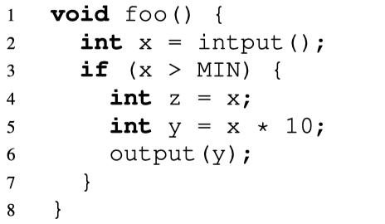
BlockScope vs. State-of-the-art Tools
Patch-based
code clone detection
ReDeBug
[SP’12]
VUDDY
[SP’17]
MVP
[Usenix’20]
VGraph
[EuroSP’20]
Language
Dependent
Hash tokenized contexts
Cannot detect Type-2
Add variable abstraction
Cannot detect Type-3
More “program analysis”
Hash-based “exact” code matching for the basic unit
This path: to generate better “hashes” (generic and more accurate)
Language
Agnostic
BlockScope
Context-based code search (to speed up)
Similarity-based code match (to cover more vulns)
Original Vuln Code
Type-2 Clone
Type-3 Clone
Our path: do not use “hash” the basic unit
but design a better way to calculate their “similarity”

Slide 13
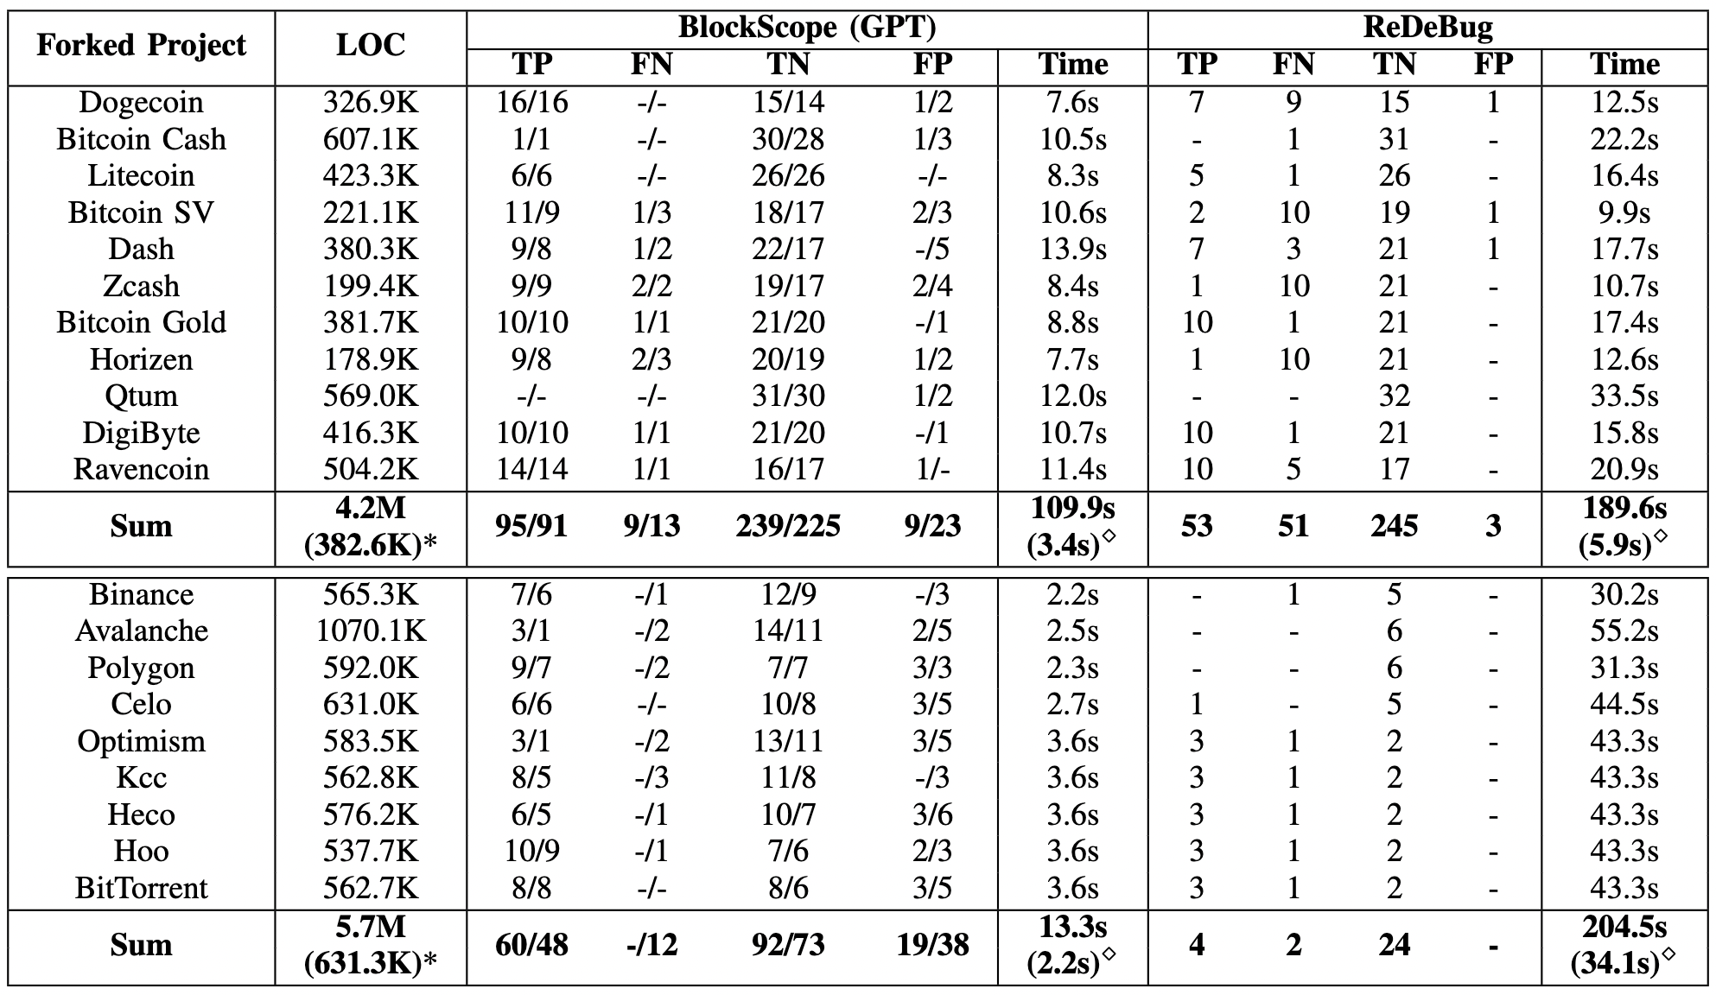
Detection Results (32 Patches from BTC & 6->19 from ETH)

Slide 14
The Breakdown for Three Clone Types
Type-1&3 clones occupy 95.5% of all the cases.
BlockScope accuracy:
Type-1: 100%;
Type-2: 80%;
Type-3: 85.7%.
ReDeBug accuracy:
Type-1: 85.7%;
Type-2: 0%;
Type-3: 26.8%.

Slide 15
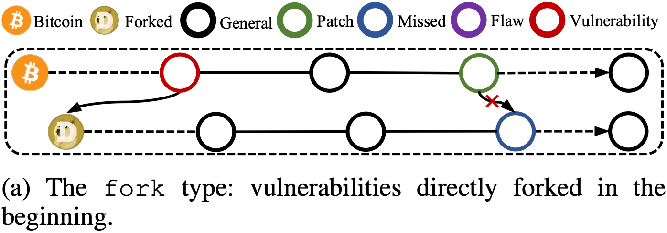
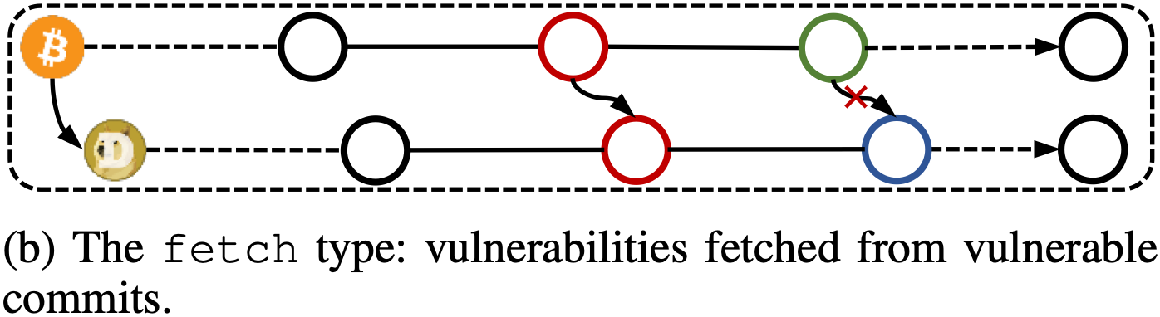
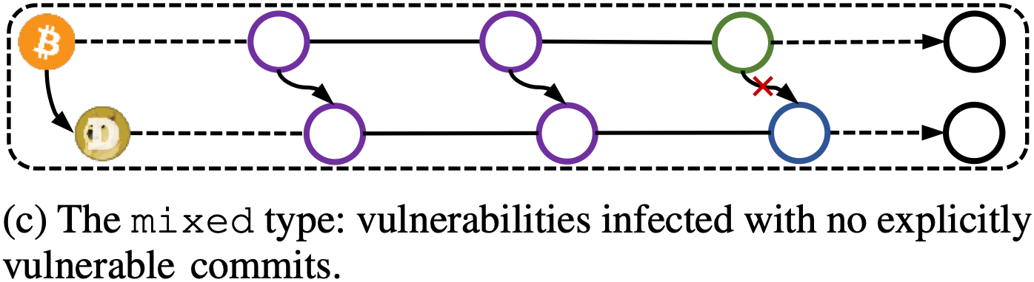
Investigation of Propagated Vulnerabilities
41 cases, e.g., CVE-2022-29177, CVE-2021-41173.
25 cases, e.g., CVE-2021-3401, CVE-2020-26265, CVE-2020-26264, CVE-2020-26260.
44 cases, e.g., Bitcoin PR#16512.

Slide 16
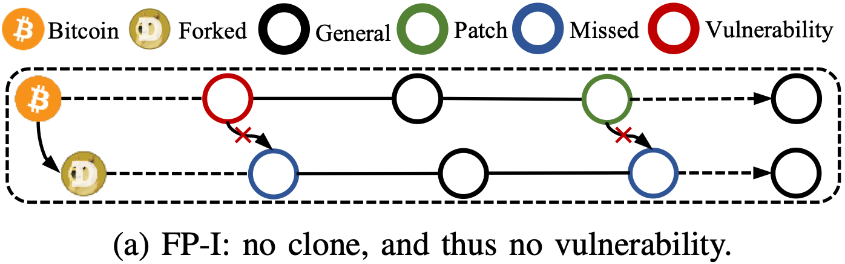
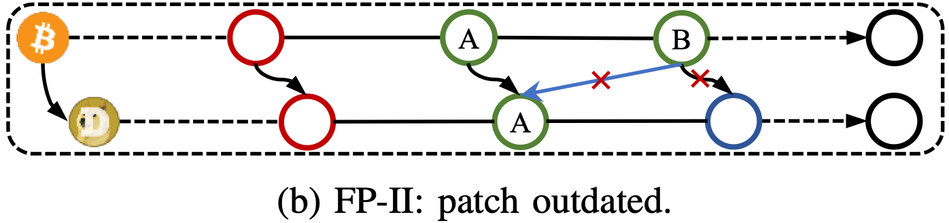
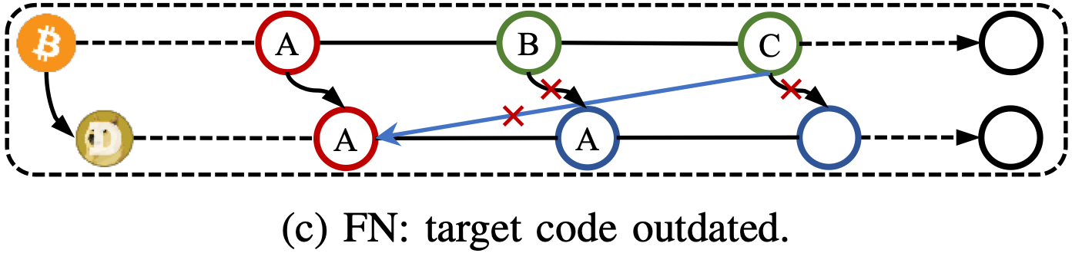
Our Limitation
FP-I: 7 cases, e.g., CVE-2018-17145, CVE-2019-15947, Bitcoin PR#12561, Bitcoin PR#14249.
FP-II: 2 cases, e.g., Bitcoin PR#12561, Bitcoin PR#13808.
FN: 9 cases, e.g., Bitcoin PR#10345, Bitcoin PR#11568, Bitcoin PR#13907.

Slide 17
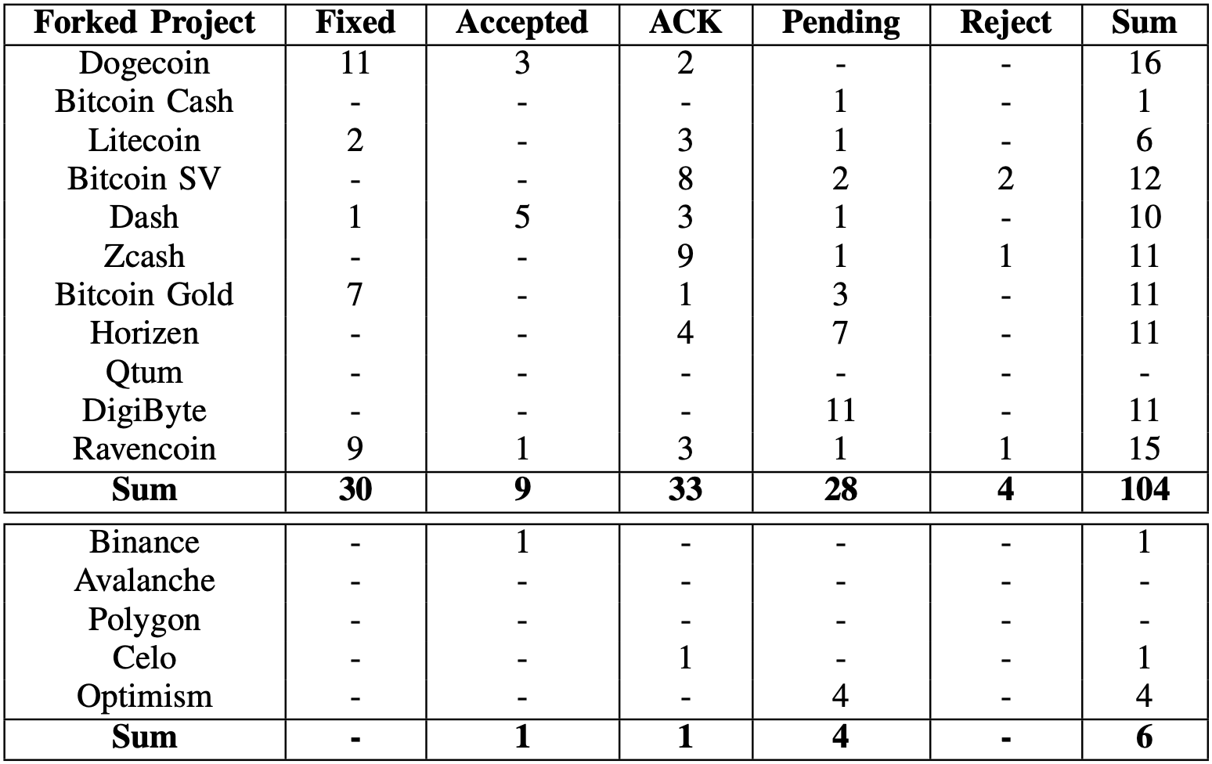
Vulnerability Report Response
Reported 110 vulnerabilities (101 TP + 9 FN);
74 positive response;
CVE-2021-37491 of Dogecoin & CVE-2021-37492 of Ravencoin
1 bug bounty from Binance;
Dogecoin, Ravencoin, Dash, Bitcoin Gold, Litecoin, and Binance are the most active ones;
Bitcoin Cash, DigiByte, and Optimism did not respond to any of our reports.

Slide 18
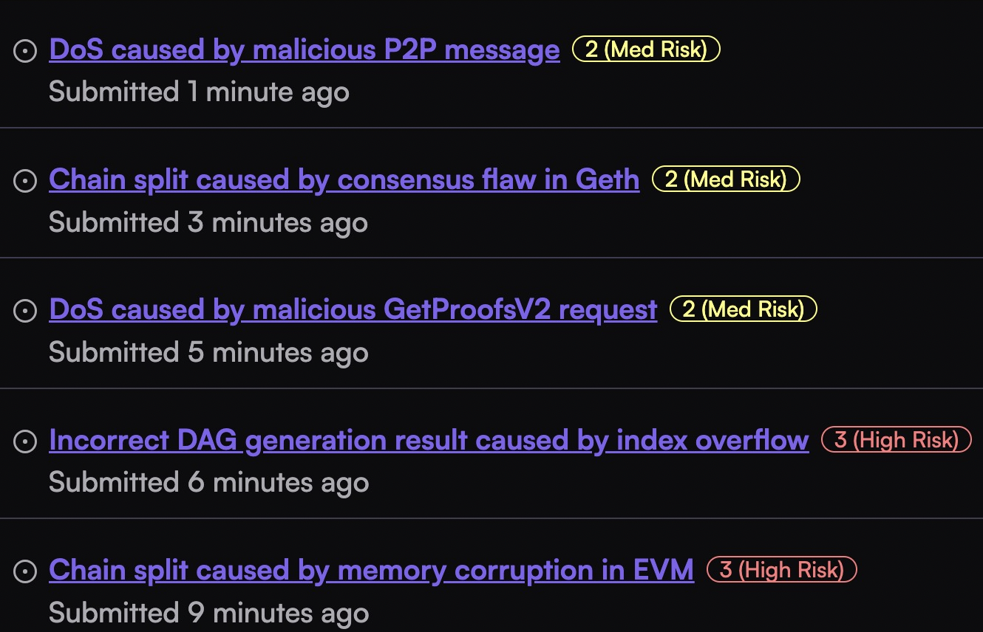
Our vulnerability discovery in BSC/Optimism/Base/Mantle

Slide 19
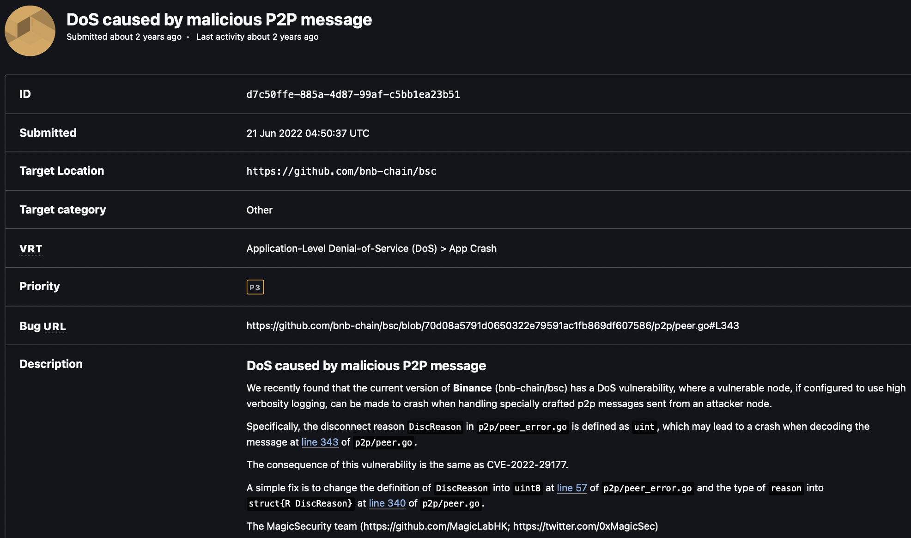
CVE-2022-29177 in Binance BSC

Slide 20
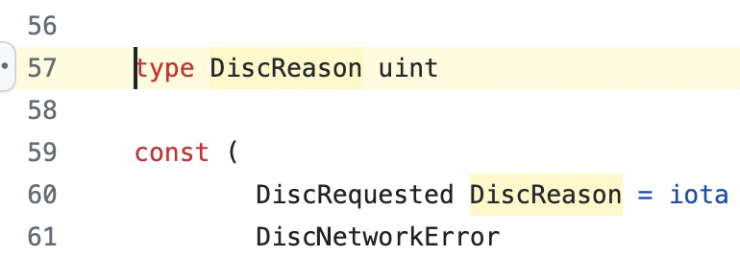
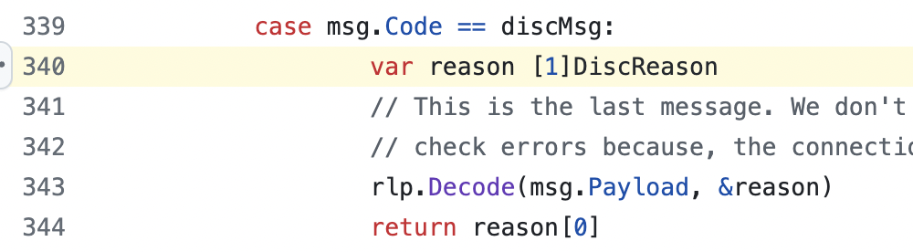
CVE-2022-29177 in Binance BSC
A vulnerable node, if configured to use high verbosity logging, can be made to crash when handling specially crafted p2p messages sent from an attacker node.
The disconnect reason `DiscReason` in `p2p/peer_error.go` is defined as `uint`, which may lead to a crash when decoding the message at line 343 of `p2p/peer.go`.
A fix is to change the definition of `DiscReason` into `uint8` at line 57 of `p2p/peer_error.go` and the type of `reason` into `struct{R DiscReason}` at line 340 of `p2p/peer.go`.

Slide 21
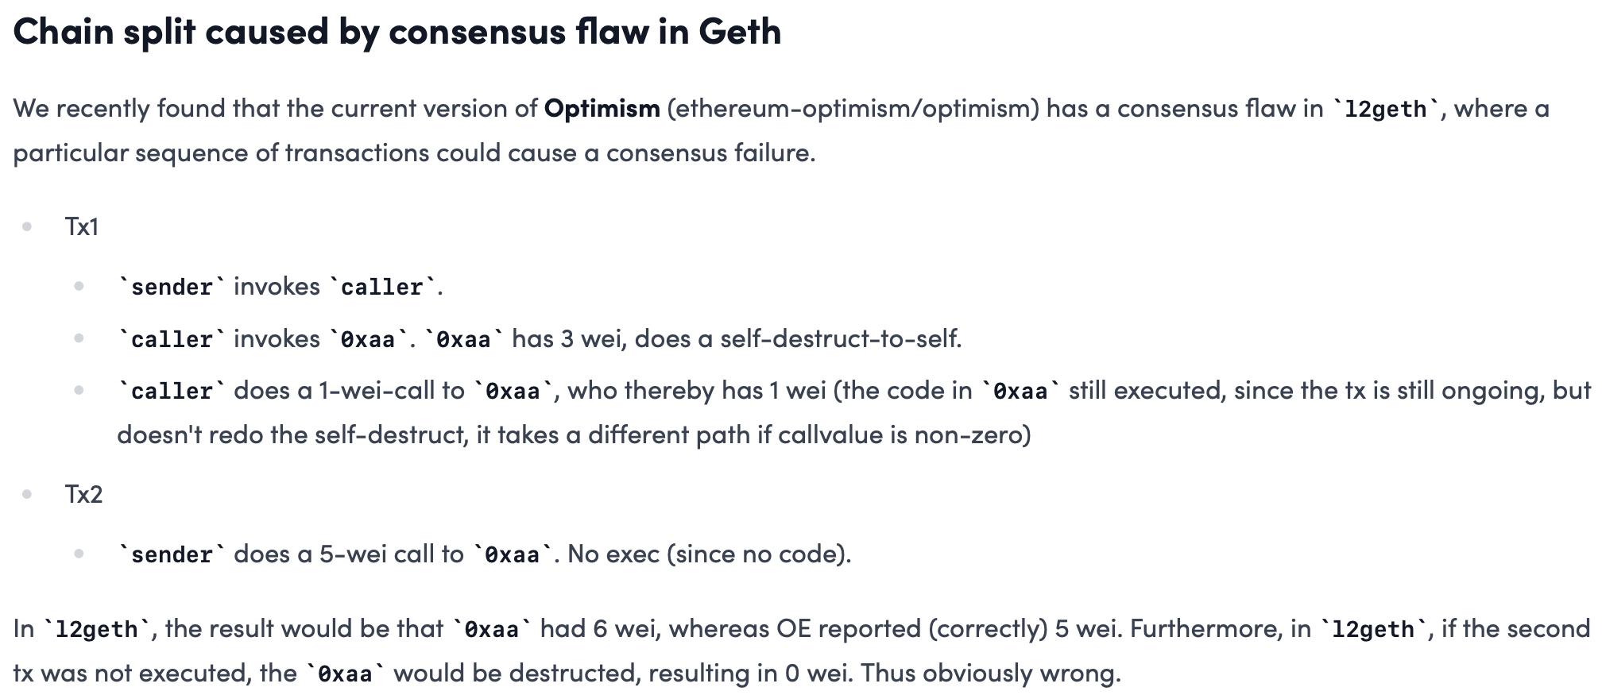
CVE-2020-26265 in Optimism

Slide 22
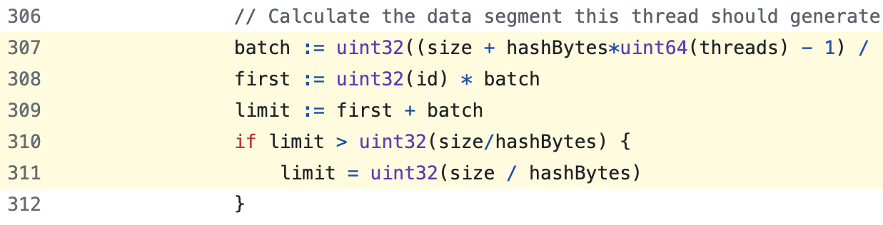
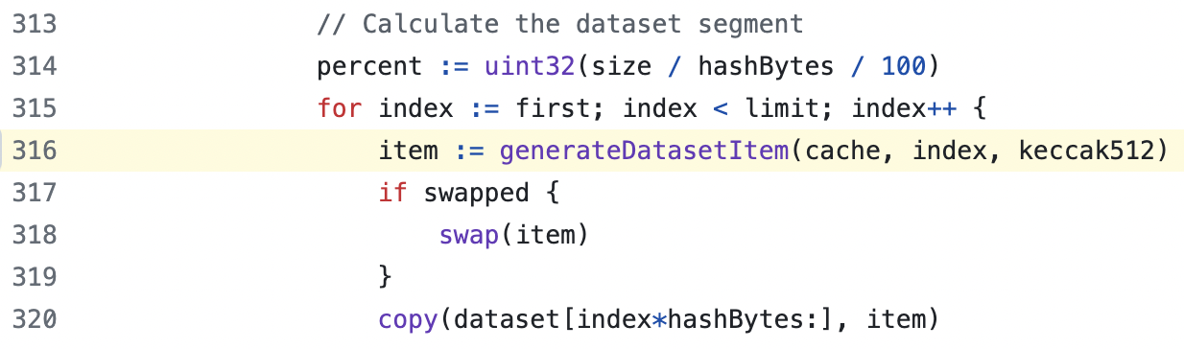
CVE-2020-26265 in Optimism
The problem lies in line 307-311 and line 316 of `l2geth/consensus/ethash/algorithm.go`. Substitute the `uint32` into `uint64` could fix the issue.

Slide 23
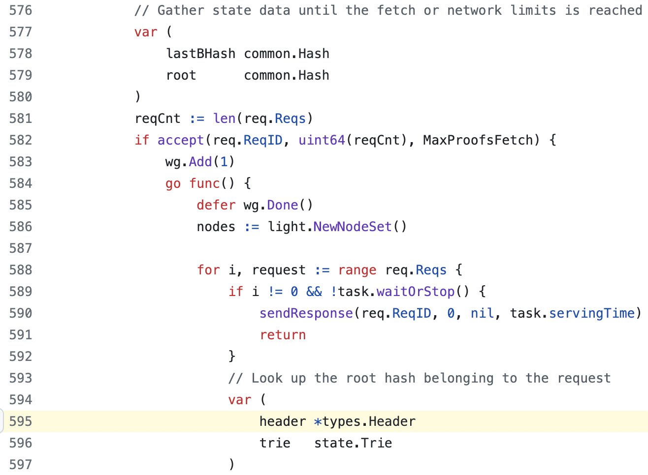
CVE-2020-26264 in Base
It had a DoS vulnerability in LES, which can make a LES server crash via a malicious `GetProofsV2` request from a connected LES client.
The problem lies in line 595 of `l2geth/les/server_handler.go`, where the `header` could potentially be `nil` and leads to a panic.
A simple solution is to move line 595 after line 579.

Slide 24
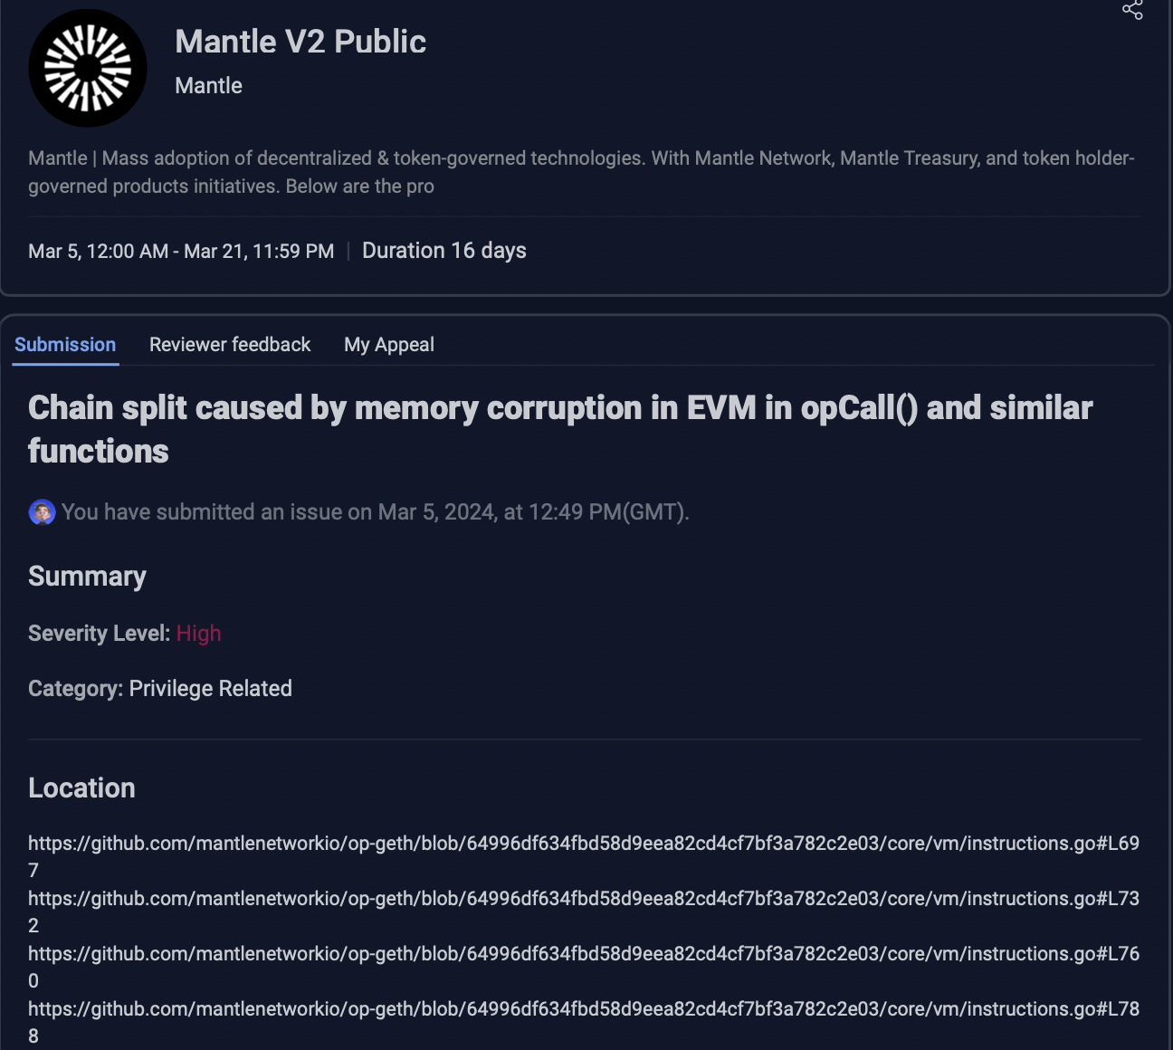
CVE-2021-39137 in Mantle
It has a memory corruption vulnerability in EVM, which can cause a consensus error.
Vulnerable nodes obtain a different `stateRoot` when processing a maliciously crafted transaction. This, in turn, would lead to the chain being split into two forks.
The problem lies in four functions, i.e., `opCall`, `opCallCode`, `opDelegateCall`, and `opStaticCall` of `core/vm/instructions.go`.
A simple solution is to use `common.CopyBytes` to copy `ret` safely before use, e.g., add `ret = common.CopyBytes(ret)` before line 698.

Slide 25
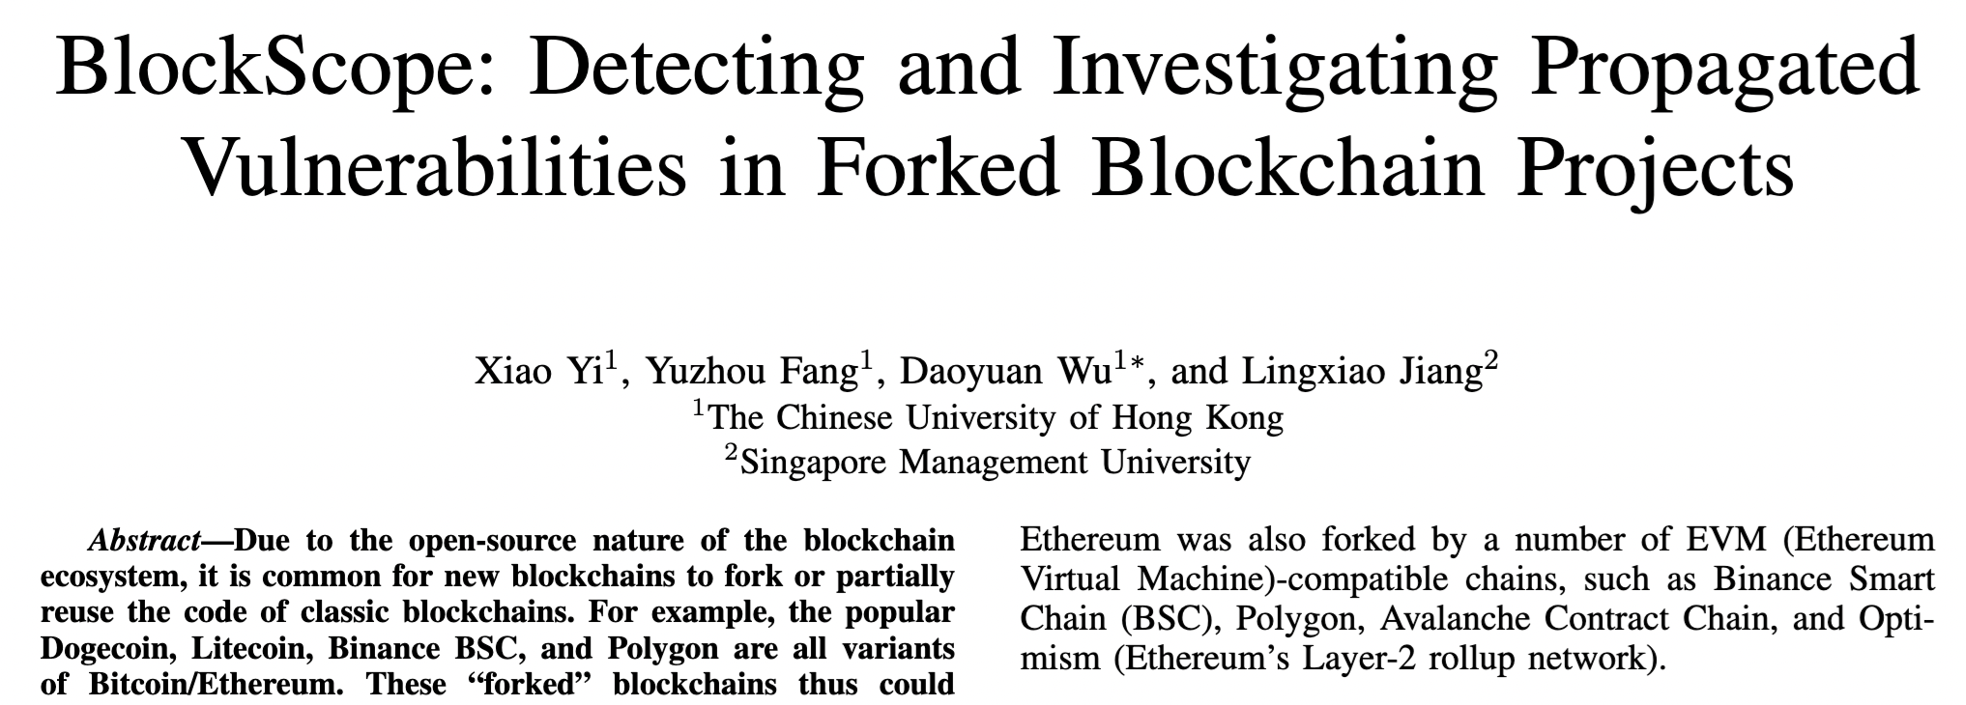
Acknowledgement
This work is made possible with my former PhD student, Xiao Yi (now a Researcher at Huawei HKRC), and Research Assistant, Yuzhou Fang (now a PhD student at USC).
BlockScope is now open-source at https://github.com/VPRLab/BlockScope.
Whitepaper: https://www.ndss-symposium.org/ndss-paper/blockscope.

Slide 26
Takeaway
Introduced our recent efforts to discover how Ethereum’s CVE vulnerabilities could propagate from Ethereum to BSC/Optimism/Base/Mantle.
Developed BlockScope (https://github.com/VPRLab/BlockScope), a novel search-based patch vs. code similarity analysis tool for discovering 100+ vulnerabilities in top blockchains.
Analyzed vulnerabilities in BSC/Optimism/Base/Mantle (1 for BSC, 4 for Optimism, and 5 for Base/Mantle).

Slide 27
Thank you! Q&A ☺ Contact: @MagkDao

